Slide 1
Banka KSD
School project related to “Booleo”

Slide 2
Process
01
03
Idea
Apps used
02
04
Realization
Our team
Idea and explanation.
What we used.
Ways of realization.
Who created the product?

Slide 3
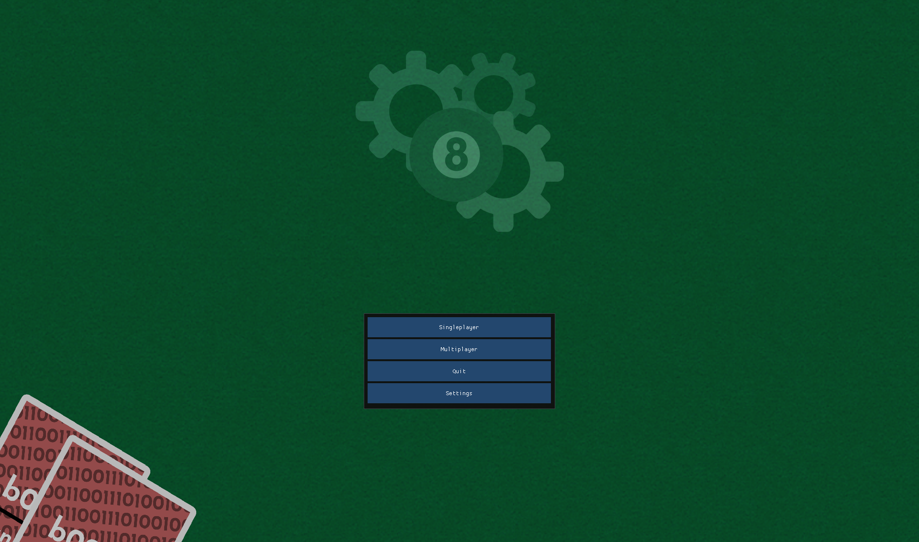
Idea
We had a total of 25 days to build up this project from the ground up with nothing but the ruleset and the initial design of the already implemented nand gate cards.

Slide 4
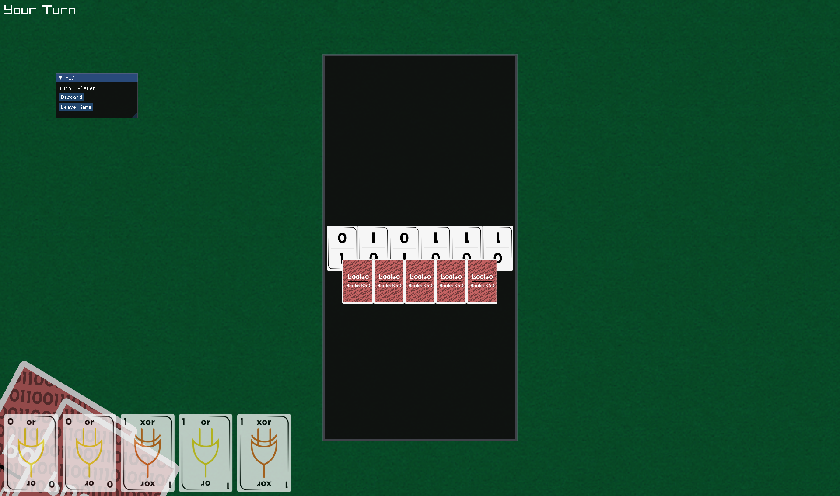
Realization
We realized our project through collaborative work across different online platforms and coding environments.
Every day we held meetings to discuss progress and responsibilities of the team members.

Slide 5
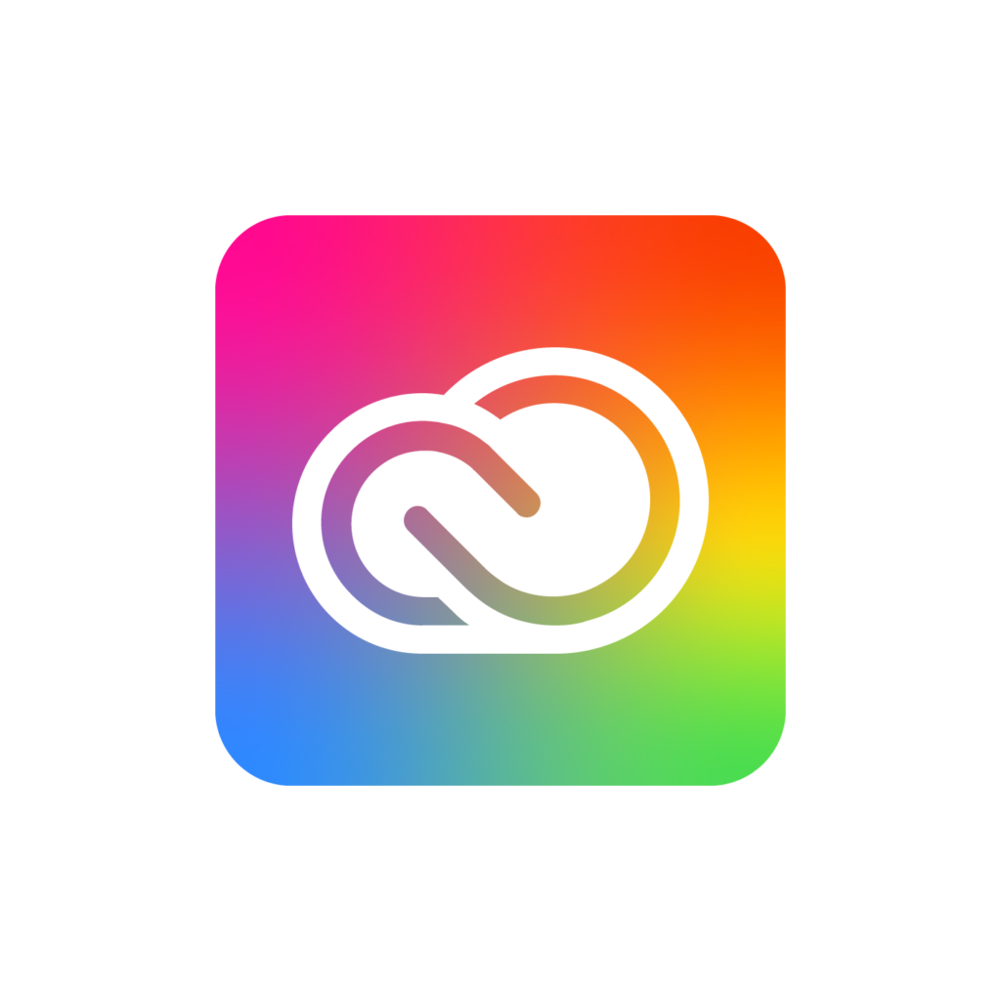
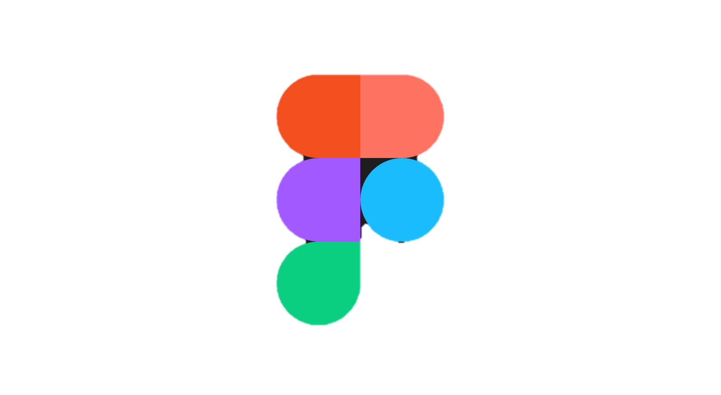



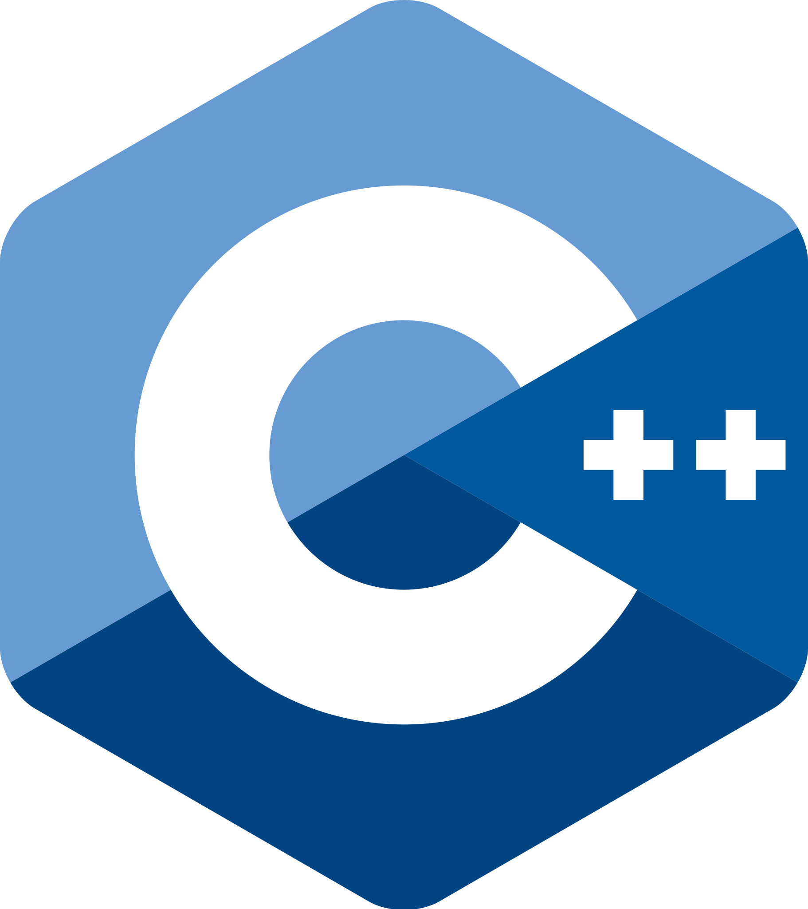




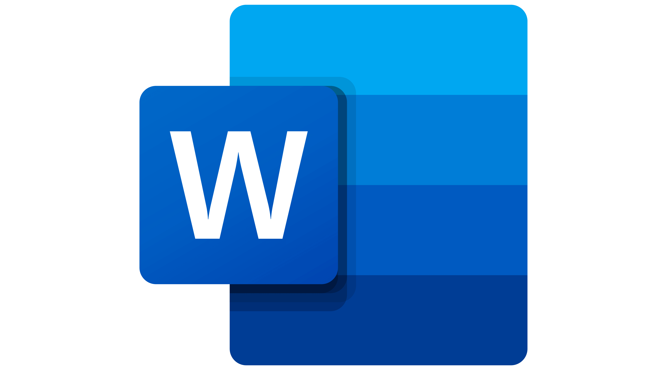


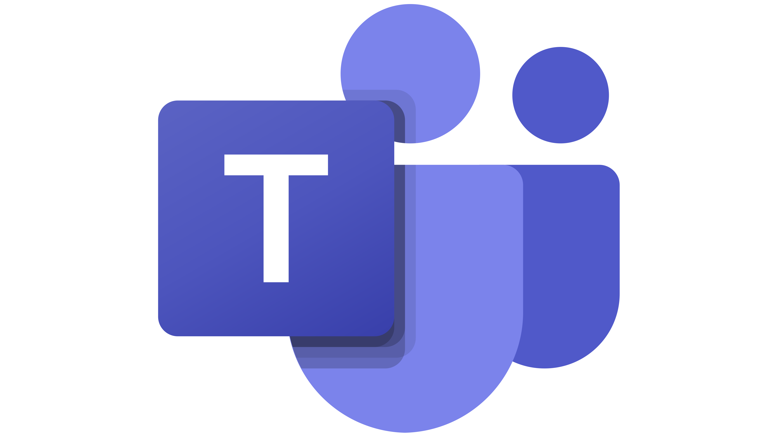
Technologies we used

Slide 6
Our team
Scrum trainer
Valeri Ivanov
Backend Developer
Alexander Manov
Backend Developer
Galin Georgiev
QA Engineer
Maxim Marinov

Slide 7
Let’s continue with the app
Does anyone have any questions?
Feel free to contact: VTIvanov20@codingburgas.bg

